Slide 1

What are the drivers of a Country’s happiness?
Arghavan Abtahi - Mariana Brinkley - Rafael Santos
Shayan Beizaee - Sandra Pastrana

Slide 2

Agenda
World Happines Analysis
Hypothesis
Data
Exploration
Analysis
Discussion

Slide 3
Hypothesis
World Happines Analysis
What are the drivers of a countries happiness?
Our Hypothesis is that a country’s happiness is directly correlated to:
The county’s economic indicators. The healthier the economic indicator the happier the happiness index.
Their weather. The warmer the weather, the happier the country.
Their musical expressions. The happier the country, the happier the music of their choice.
Their tourism. The happier the country, the more tourism it will attract.
Their athletes. The happier the country the more Olympic athletes will represent them.
Hypothesis | Data | Exploration | Analysis | Discusion |

Slide 4
Data
World Happines Analysis
Questions we asked:
1. How happy is the world?
Data: World Happiness Report: http://worldhappiness.report/ed/2018/
2. How does happiness correlate with economic indicators:
Data: World Happiness Report: http://worldhappiness.report/ed/2018/
Data: The world bank indicators API http://api.worldbank.org
Hypothesis | Data | Exploration | Analysis | Discusion |

Slide 5
Data
World Happines Analysis
Questions we asked:
3. How does tourism correlate with happiness?
Data:
4. How does happiness correlate with weather:
Data: Open Weather API
Hypothesis | Data | Exploration | Analysis | Discusion |

Slide 6
Data
World Happines Analysis
Questions we asked:
1. How happy is the world?
Data: World Happiness Report: http://worldhappiness.report/ed/2018/
2. How does happiness correlate with economic indicators:
Data: World Happiness Report: http://worldhappiness.report/ed/2018/
Data: The world bank indicators API http://api.worldbank.org
Hypothesis | Data | Exploration | Analysis | Discusion |

Slide 7
Data
World Happines Analysis
Questions we asked:
3. How does tourism correlate with happiness?
Data:
4. How does happiness correlate with weather:
Data: Open Weather API
Hypothesis | Data | Exploration | Analysis | Discusion |

Slide 8
Data
World Happines Analysis
Questions we asked:
5. Is there are relationship between how happy the country and the kind of music they choose to listen and prefere?
Data needed:
Representative sample of top songs per country through out the year.
Characteristics of each song rating: happiness, energy, speachiness and istrumentalness.
Data sources:
Spotify, Spotypy API
Hypothesis | Data | Exploration | Analysis | Discusion |

Slide 9
Exploration & Analysis – Happiness Index
World Happines Analysis
Hypothesis | Data | Exploration & analysis | Discusion |

Slide 10
Exploration & Analysis – Wheather
World Happines Analysis
Hypothesis | Data | Exploration & analysis | Discusion |

Slide 11
Exploration & Analysis – Tourism
World Happines Analysis
Hypothesis | Data | Exploration & analysis | Discusion |

Slide 12
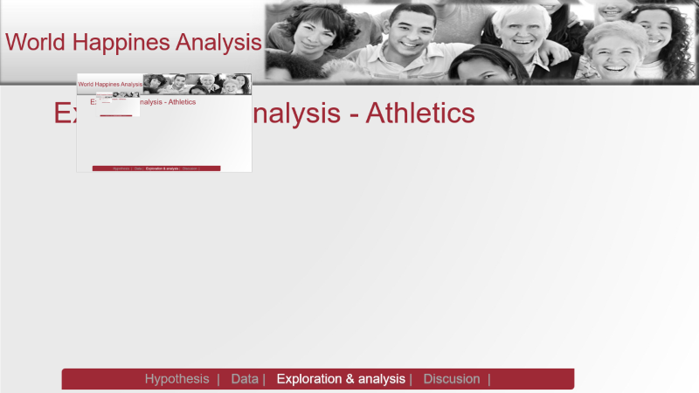
Exploration & Analysis - Athletics
World Happines Analysis
Hypothesis | Data | Exploration & analysis | Discusion |

Slide 13

Exploration & Analysis – Economic Indicators
World Happines Analysis
Hypothesis | Data | Exploration & analysis | Discusion |

Slide 14
Exploration & Analysis – Musical expression
World Happines Analysis
Hypothesis | Data | Exploration & analysis | Discusion |

Slide 15
Vida en Expatriación
Discussion
Hypothesis | Data | Exploration & analysis | Discussion |

